Slide 1

Capstone Project

Slide 2



Personal BACKGROUND
(Name, Past Experience, Qualification, Career Summary)
Name :Devalla Baladithya
Past Experience : Fresher
Qualification : BTECH
Career Summary : I am a student recently joined Ascendion as Fresher
www.collaberadigital.com

Slide 3


Key Takeaways/Learnings from the Program
Built a strong foundation in software engineering – learning how to think about architecture, scalability, performance, and security from the start.
Gained hands-on experience with web technologies – HTML5, CSS3, JavaScript, and TypeScript.
Learnt to develop modern applications using React and Angular, from basics to advanced patterns.
Understood the importance of clean design and reusable components through architecture and design patterns.
Explored backend development with Node.js, Express.js, REST APIs, and databases like MongoDB.
Practiced modern development workflows – Git, CI/CD pipelines, Docker, testing, and deployment on cloud platforms.
Improved performance optimization skills – working with lazy loading, caching, Core Web Vitals, and scalable project structures.

Slide 4

Problem Statement of the Capstone Project
This project focuses on developing a lightweight, end-to-end Insurance Management Web Application. The goal is to create a functional application with core insurance features, prioritizing security, scalability, and modern development practices.
Key Functional Requirements:
The application supports three user roles: customer, agent, and admin. Core features include:
Authentication & User Management: User registration, login, and JWT-based session management.
Policy Management: Browsing, purchasing, and managing policies for customers.
Claims Processing: Customer claim submission; agent/admin processing (updating status).
Simulated Payments: Recording policy payments without a real payment gateway.
Admin & Agent Functions: Admin oversight, agent management, audit logs, and KPI reports.

Slide 5

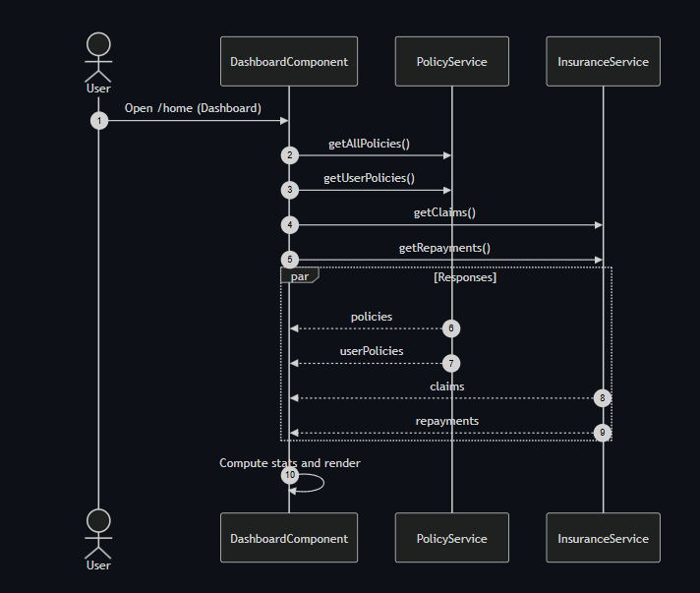
WORK FLOW SEQUENCE

Slide 6
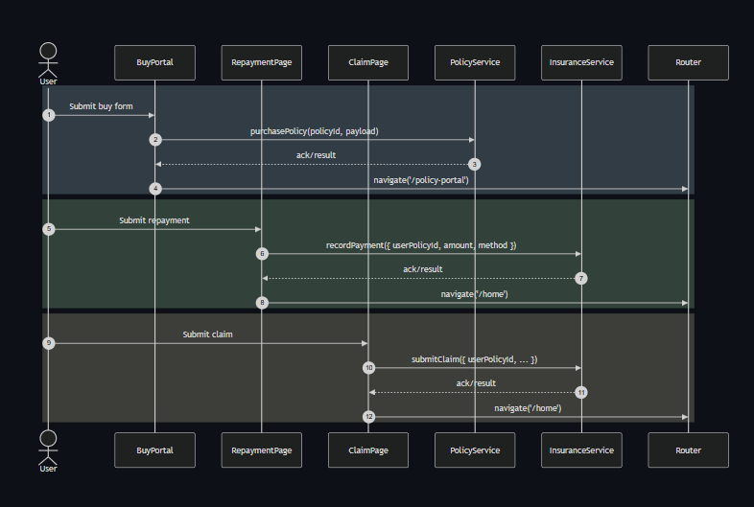
WORK FLOW SEQUENCE

Slide 7
This project is an end-to-end Insurance Management Web Application. An Angular frontend captures user data, which is validated by a Node.js/Express backend, stored in MongoDB, and displayed on dashboards. The goal is a lightweight platform for managing policies, claims, and users.
The project includes:
Data Ingestion and Validation: User data is ingested via REST API endpoints, with backend validation for security and processing.
Standardization of Data and Schema Finalization: Data structures are defined using Mongoose schemas for Users, Policies, and Claims, standardizing values like user roles and claim statuses.
Applying Business Logic based on Requirements: Backend services implement business logic for policy purchases, claim submissions, and admin KPI viewing, manipulating data based on user roles.
Visualizing the Results in a User Interface: An Angular application visualizes results through customer, agent, and admin dashboards for policies, claims, and management tasks, respectively.

Slide 8
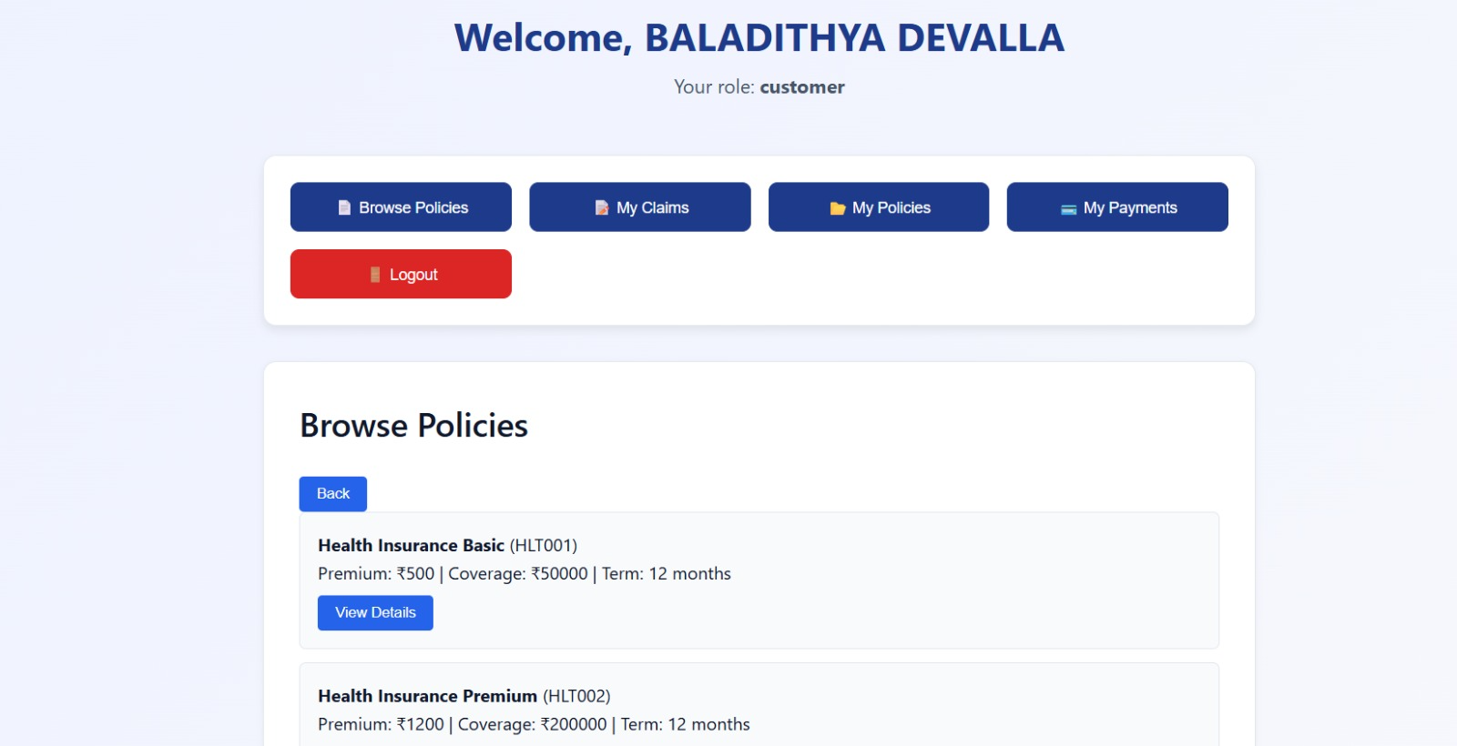
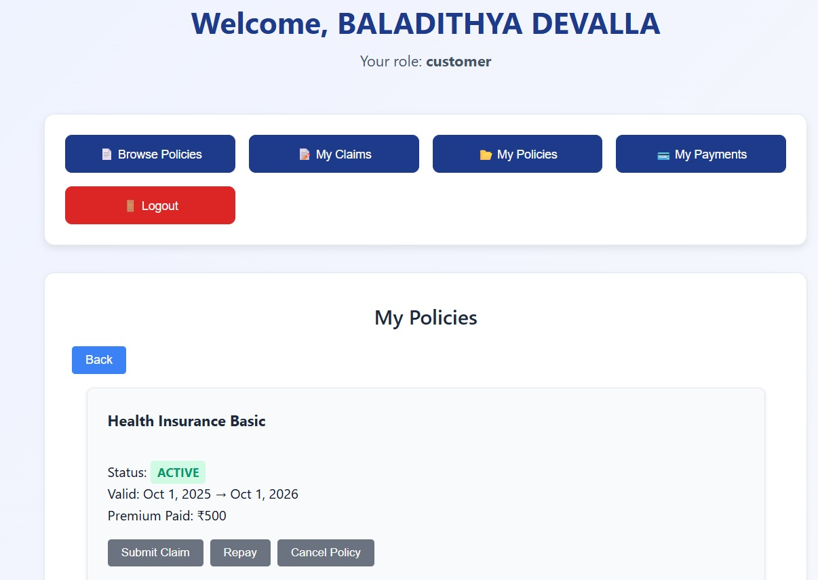
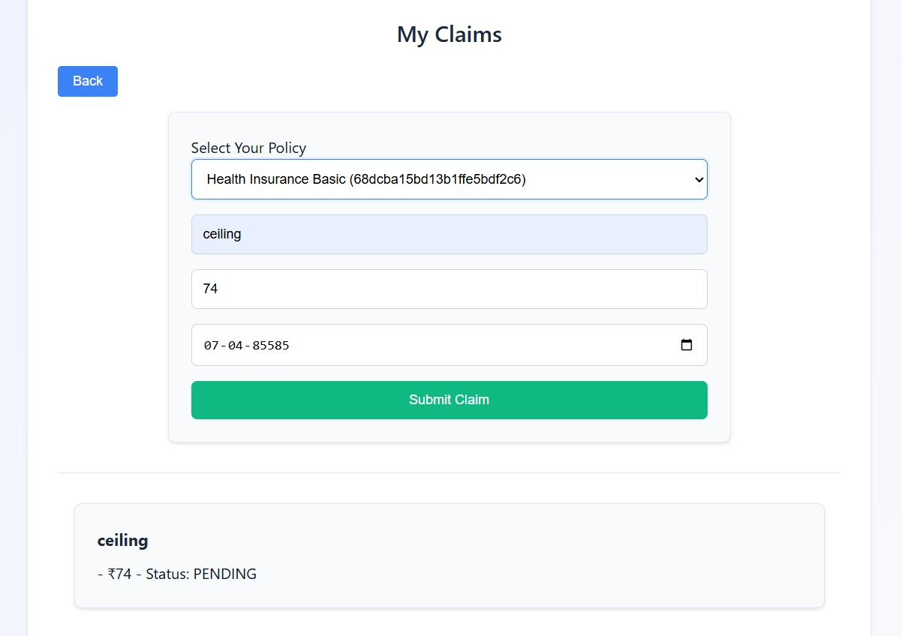
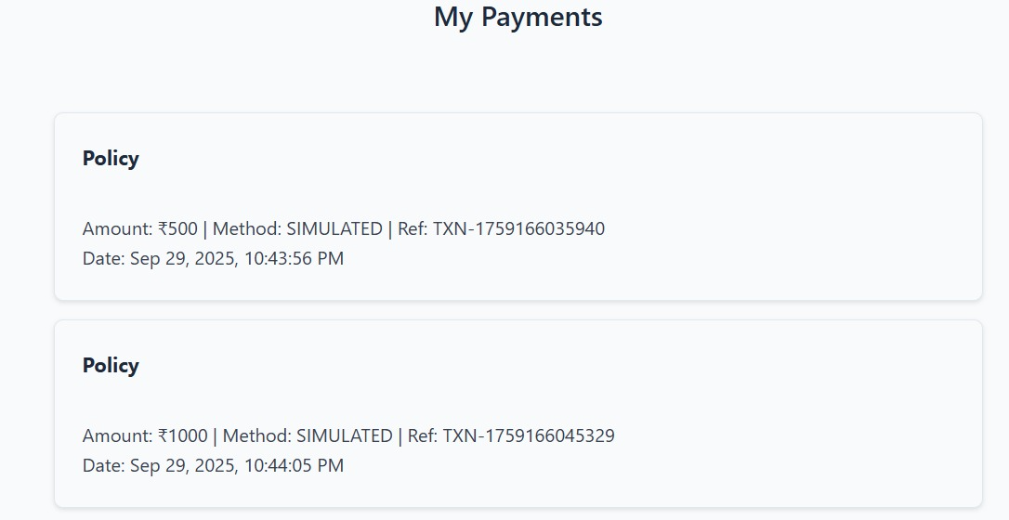
Login Register and User DashBoard Components

Slide 9
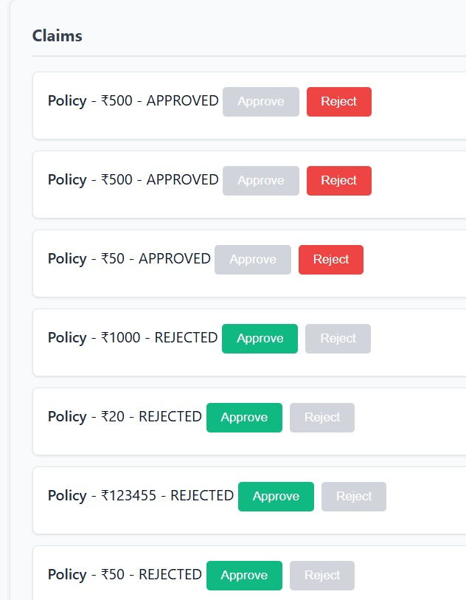
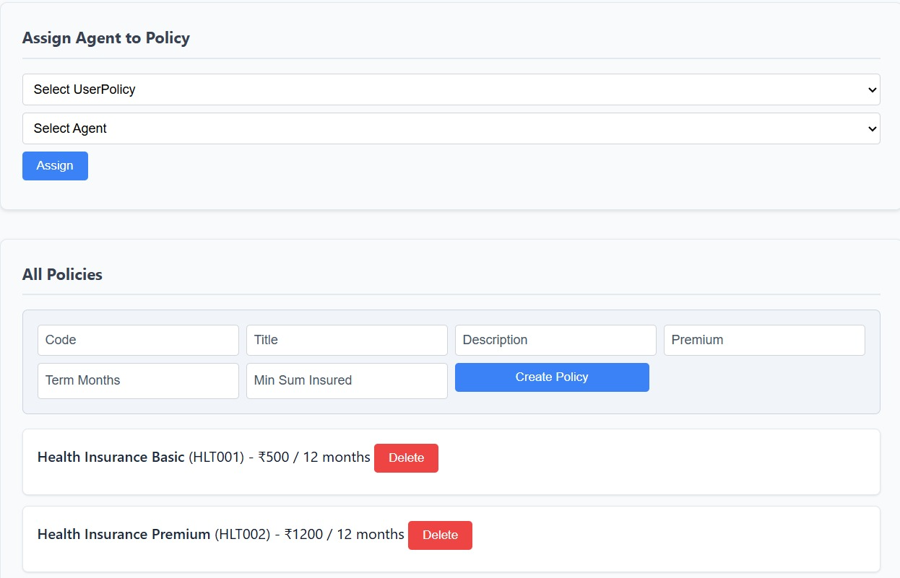
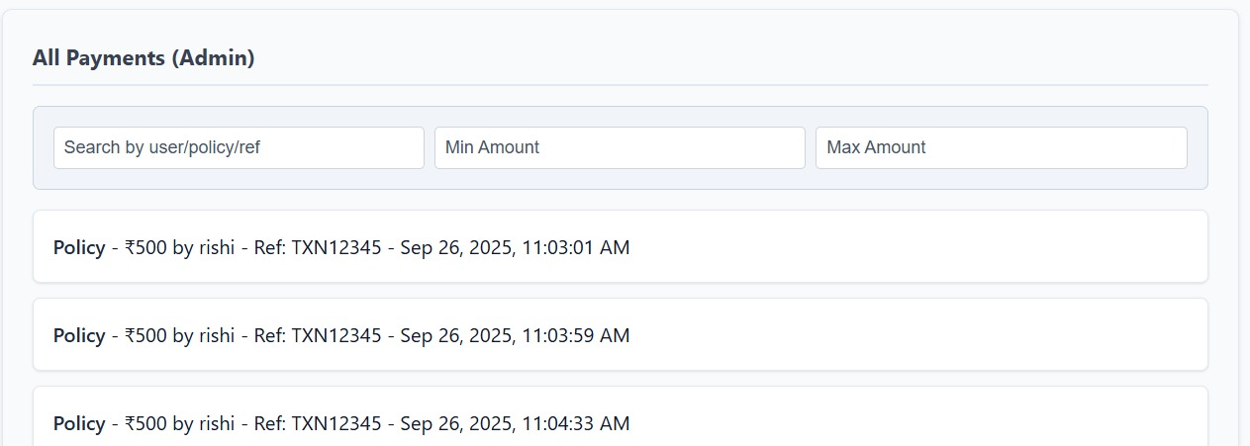
Admin DashBoard Agent Management Components

Slide 10
Conclusion
The Insurance Management System provides a unified
platform for Admin, Agent, and Customer roles.
Uses REST APIs for efficient data access and
operations.
Angular + Behaviour Subject ensures a responsive, state-managed frontend
experience.
Cloudinary handles secure and scalable storage of claim
documents.
End-to-end workflow ensures streamlined operations, real-
time updates, and enhanced customer experience.

Slide 11
Thank You

